Slide 1
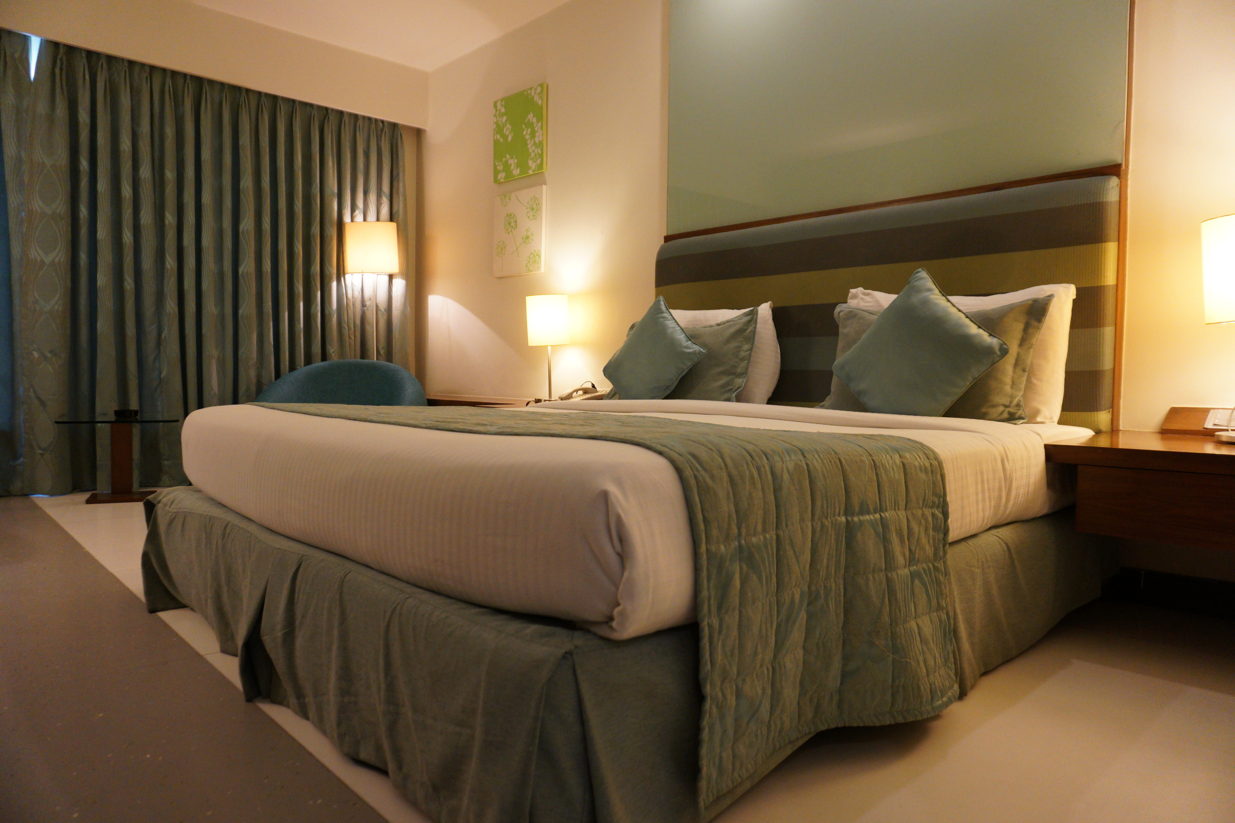
HOTEL RESERVATION ANALYSIS

Slide 2

BUSINESS PROBLEM
The hotel industry relies on data to make informed decisions and provide a better guest experience. The Task is to gain insights into guest preferences, booking trends, and other key factors that impact the hotel's operations.
.

Slide 3
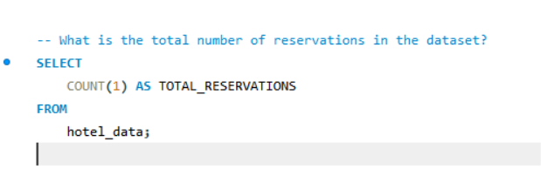
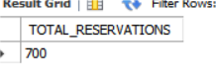
Question 1

Slide 4
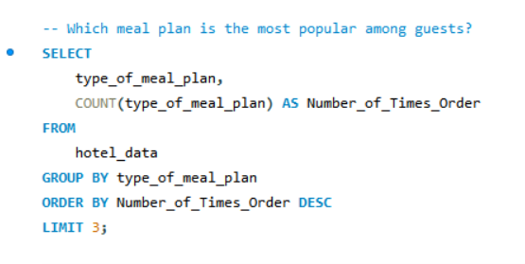
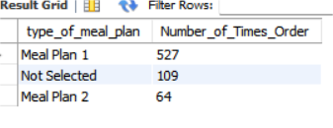
Question 2

Slide 5

INSIGHTS
TOTAL RESERVATION
Most popular Meal plan among guests
700
Meal plan 1 - 527 times order
The total count of reservations gives an overview of the volume of guests served over the dataset's time period. A higher number indicates a busy operation and possibly high demand.
The meal plan with the highest count reveals guest preferences regarding meal options. This insight can help the business focus on the most demanded meal plan, potentially improving guest satisfaction and optimizing menu offerings.

Slide 6
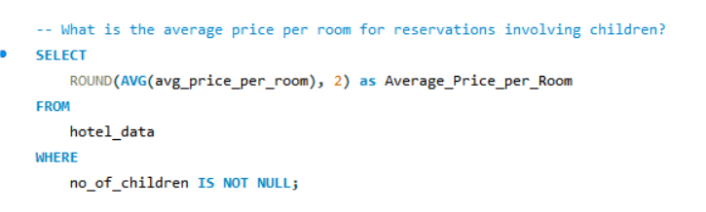
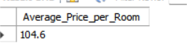
QUESTION 3

Slide 7
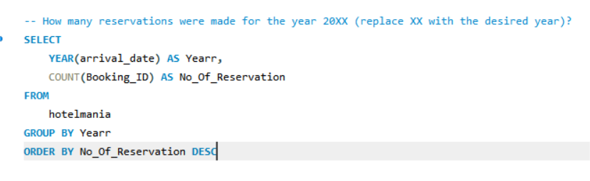
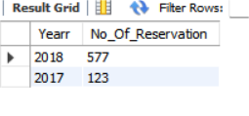
Question 4

Slide 8

INSIGHTS
RESERVATION year wise
Average Price per room
577(2018)
123(2017)
104.6
Average price helps to understand the pricing trend for reservations that include children. It can provide insights into whether rooms booked for families with children are priced higher, lower, or similar compared to other reservations.
Reservation year wise provides the total number of reservations for a given year. This is useful for year-over-year comparison, trend analysis, and assessing the impact of marketing strategies or economic conditions.

Slide 9
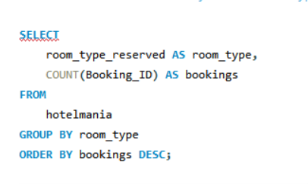
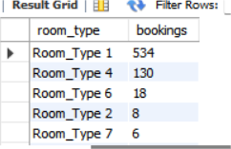
Question 5
what is the most commonly booked room type?

Slide 10
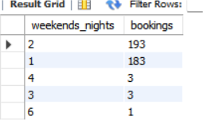
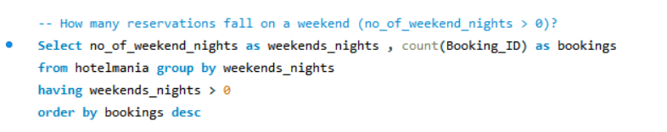
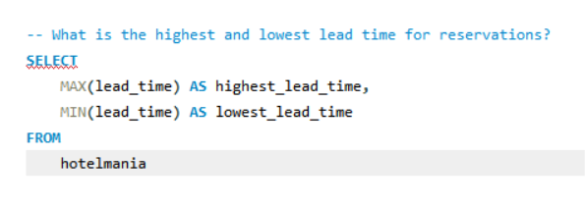
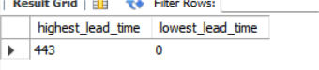
Question 6
Question 7

Slide 11

INSIGTHS
lead_time: The number of days between booking and arrival.
Most Commonly Booked Room Type
Room Type 1 - 534 bookings
Highest - 443 days And Lowest - 0 days
Helps identify the most popular room type, which can inform pricing strategies and promotional efforts.
Indicates the volume of weekend stays, which is critical for revenue management and special event planning.
Provides insights into booking behaviors, helping with forecasting demand, managing inventory, and tailoring marketing strategies to different booking windows.

Slide 12
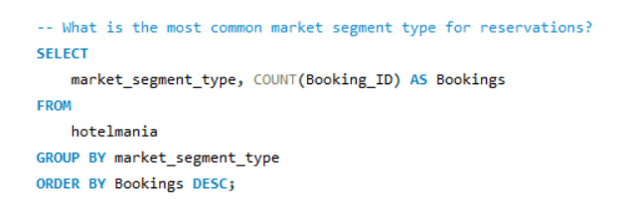
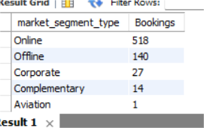
Question 8

Slide 13
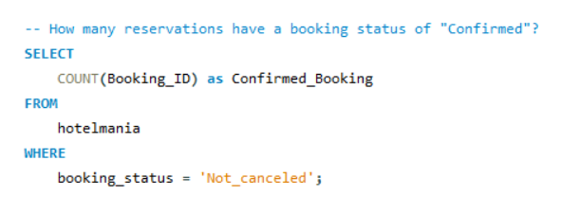
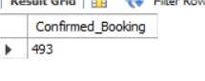
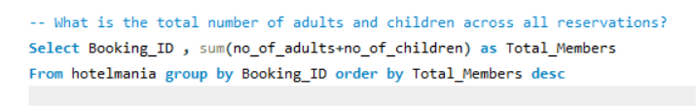
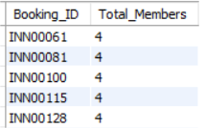
Question 9
Question 10

Slide 14
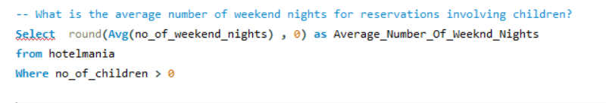
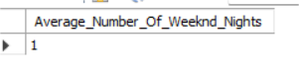
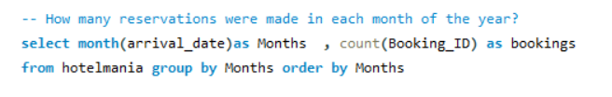
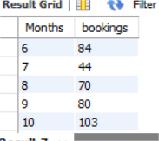
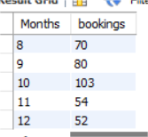
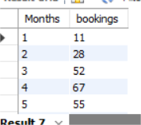
Question 11
Question 12

Slide 15
INSIGHTS
A high number of confirmed reservations, such as 493, reflects a healthy booking status, ensuring solid occupancy and revenue forecasts.
Understanding that there are adults and children across reservations helps in planning amenities, activities, and services tailored to these demographics.
An average of 2 weekend nights for families indicates a trend toward weekend stays, suggesting that marketing efforts could focus on enhancing weekend family packages and activities.
Identifying peak booking months, such as June and December, aids in strategic planning for promotions, staffing, and resource management during high-demand periods.

Slide 16
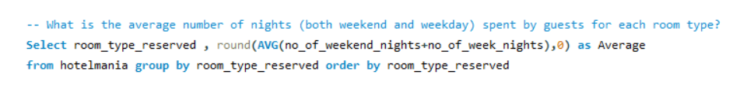
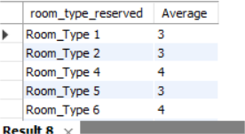
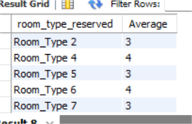
Question 13

Slide 17
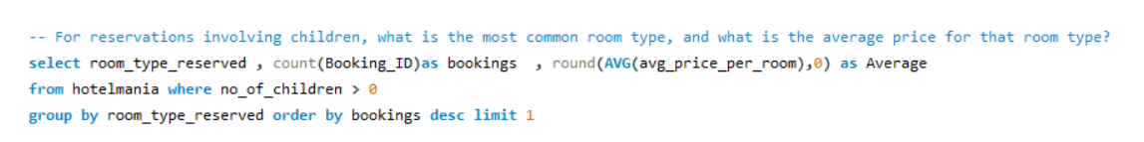
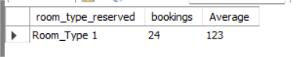
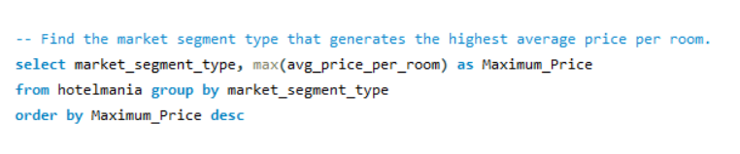
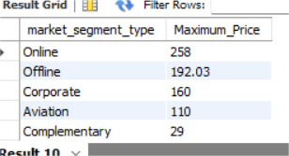
Question 14
Question 15

Slide 18
INSIGHTS
Understanding that guests in Deluxe Rooms spend an average of 5 nights while those in Standard Rooms spend 3 nights helps tailor services and pricing strategies. Longer stays might indicate a preference for more comfortable or luxurious accommodations.
Identifying the Family Suite as the most common room type for families, with an average price of 123 rupees per night, highlights the importance of family-friendly amenities and can drive promotions targeting families.
The Corporate segment generating the highest average room price (258 rupees per night) indicates the potential for high revenue from business travelers. Focusing on this segment with specialized services can maximize revenue.

Slide 19

Thank You

